Slide 1
House Human Services Committee Interim Charge: Foster Care Redesign
Judge John Specia, DFPS Commissioner
April 15, 2014

Slide 2
Interim Charge
Monitor the implementation of Foster Care Redesign and evaluate its impact on the child welfare system in areas of the state where redesign is underway, including transition from the legacy system, foster family retention and recruitment, placement stability, permanency, and child safety
Discuss the Texas adoption process
Child safety data and safety efforts

Slide 3
Goals of Foster Care Redesign
Through Redesign, DFPS seeks to:
Promote positive outcomes for children, youth, and families.
Improve the overall process and quality of care.
Buy services where they are needed and reward good performance.
Utilize and build on the strengths of communities.
Goals of Redesign:
Keep children and youth closer to home and connected to their communities and siblings.
Improve the quality of care and outcomes for children and youth.
Reduce the number of times children move in foster care.

Slide 4
Legislation Guiding Foster Care Redesign
SB 218 by Nelson - 82nd
Requires DFPS to implement a redesign of the foster care system in accordance with the PPP’s Foster Care Redesign report.
HB1, Rider 25 - 82nd
Requires DFPS to submit a report that includes expenditures for foster care and progress toward achievement of improved outcomes for children, youth and families based on the quality indicators.
SB 1, Rider 29 - 83rd
Requires DFPS report selected performance measures that will allow for comparative analysis between the legacy foster care and redesigned foster care systems; and
The most recent data for the selected comparative performance measures, an analysis of the data that identifies trends and impact, identification and analysis of factors negatively impacting any outcomes, recommendations, and other information necessary to determine the status of Foster Care Redesign.

Slide 5
Foundational Principles of Foster Care Redesign
All children and youth are:
Safe from abuse and neglect in their placement
Placed with their siblings in their home communities
Appropriately served in the least restrictive environment that supports minimal moves
Provided opportunities to participate in decisions that impact their lives
Able to maintain important connections to family and others
Services respect the child’s culture
Youth are provided opportunities, experiences and activities similar to those experienced by their non-foster care peers so they can be fully prepared for successful adulthood.

Slide 6
How Does Foster Care Redesign Improve How We Do Business?
Changes the way DFPS procures for foster care and other purchased services
From an open enrollment to a competitive procurement process
Changes the way DFPS contracts for foster care and other purchased services
Move to performance-based contracts
Changes the way DFPS pays for foster care and other purchased services
From multiple rates to a single blended foster care rate and allocation
Implemented through a staged approach based on Single Source Continuum Contract performance

Slide 7
Foster Care Redesign Model Development
Stakeholder Input
Public Private Partnership (PPP)
Serves as the Guiding Body for Redesign
Members represent key stakeholder groups
Tasked with making recommendations about the foster care system to the DFPS Commissioner
A broad base of stakeholders
Participated in regional and statewide forums
Gathered input from state foster youth and alumni

Slide 8
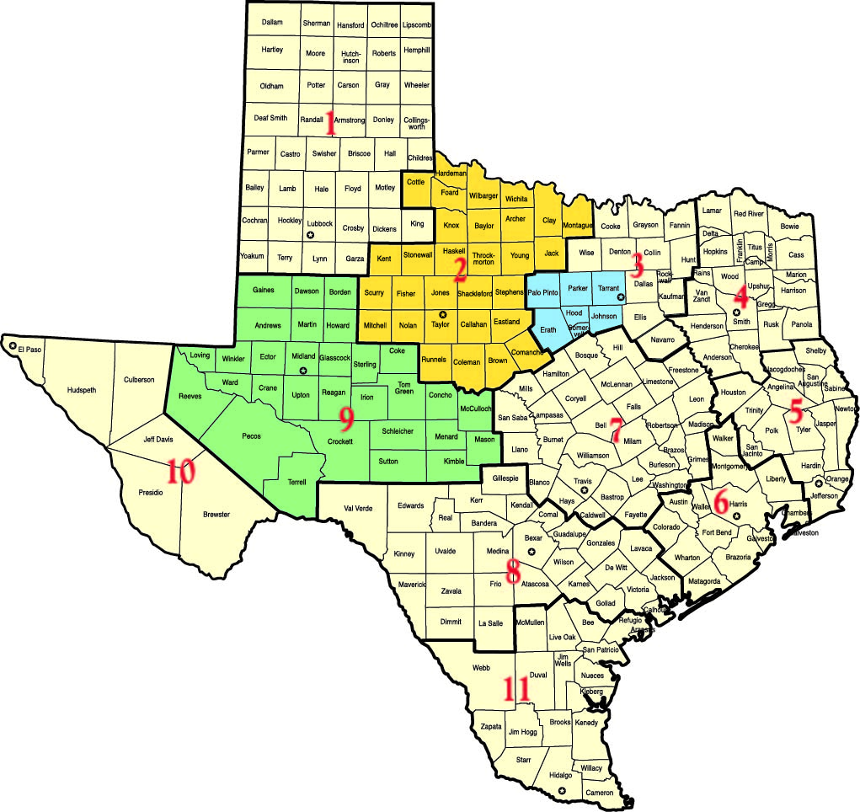
Foster Care Redesign Locations

Slide 9
Regions 2 & 9 Providence Service Corporation
Initial Non-Metropolitan Catchment Area
First Single Source Continuum Contract (SSCC) awarded to Providence Service Corporation of Texas (PSC) in December 2012 under Foster Care Redesign.
Catchment area includes 60 counties with population hubs located in Wichita Falls, Abilene, San Angelo and Midland/Odessa
Six-month start-up period: February 1st-August 25th 2013
First Child referred to PSC: August 26th 2013

Slide 10
Regions 2&9 Providence Service Corporation
Performance Metric | Indicators | 2 Year Baseline | Target for SSCC Performance | Actual Performance 8/26/13-11/30/13 | Actual Performance 12/1/13-2/28/14
Safety | % who do not experience abuse, neglect, or exploitation while placed with SSCC | 99.7% | 100% | 100% | 100%
Stability | % who did not have a placement change during the previous 12 months, counting only changes that occur while in the SSCC’s care | 64.1% | 66.1% | 94.1% | 87.9%
Maintaining Connections | % of cases where all siblings are placed together | 63.6% | 64.6% | 76.3% | 60.3%
Maintaining Connections | % who have at least one monthly contact with a significant other or family member who is not a parent or sibling | 78.7% | 80.7% | 81.9% | 82.8%
Youth fully prepared for adulthood | % of 17 year olds who have completed PAL Life Skills Training | 75.3% | 80.0% | 66.7% | 88.2%
Least Restrictive Placement | % placed in foster family home | 68.1% | 69.1% | 57.9% | 66.6%

Slide 11
Outcome Evaluation Process
DFPS is currently assessing permanency outcomes, placement stability, and re-entry rates with the assistance of the University of Chicago’s Chapin Hall
The University of Colorado’s Kempe Center for the Prevention and Treatment of Child Abuse and Neglect is providing assistance with the work to assess the percentage of placements made within 50 miles of the child’s home of removal.
Performance data will be reported and published on website every 6 months.
A Continuous Quality Improvement process will be used to help ensure every opportunity to improve outcomes for children and youth in the care of the SSCC.

Slide 12
What Have We Learned During The Initial Implementation?
Automation:
Increase testing prior to the start-up phase and allow SSCC early access to automation system
Require SSCCs to have trained and dedicated resources to manage information technology (IT) issues
Communication:
Partner with SSCCs in the development of a meaningful communication plan and develop and deliver joint presentations to key stakeholders
Ensure regular communication with PPP (quarterly meetings)
Structure and Organization:
Ensure that the SSCC staff and the DFPS staff responsible for developing catchment plans and protocols are well informed decision-makers
Establish very clear communications channels, including monthly face-to-face meetings, within and between DFPS and the SSCC

Slide 13
Region 3b ACH Child and Family Services
Initial Metropolitan Catchment Area
Second SSCC contract awarded to ACH Child and Family Services (ACH) of Fort Worth in December 2013.
Six-month start-up period: Jan. 1st - June 30th 2014
Begin transition of children from legacy system to ACH Redesign model July 1, 2014
New and subsequent placement referrals will begin Sept. 1, 2014

Slide 14
Region 3b ACH Child and Family Services
The ACH model includes:
Increasing the capacity of existing providers and identify more community-based supports and services.
Conducting a comprehensive assessment of community needs and an analysis to find gaps between the need for services and their availability.
Ensuring comprehensive safety and risk assessments to evaluate family strengths and needs.
Utilizing a trauma-informed and trauma-based care service approach.
Use of a comprehensive continuous quality improvement (CQI) process to assess, inform, and guide how services are provided and the system improved.

Slide 15
Next Steps
Foster Care Redesign is a dynamic process where information and data are gathered, shared with stakeholders and used to inform changes as the state continues its cascading roll-out.
DFPS will be posting performance data, and making it available to the PPP as they make their recommendations.
DFPS anticipates announcing the next catchment in May 2014 and releasing the next RFP in the late summer 2014.

Slide 16
How Can You Adopt a Child in Texas?
There are two options for adoption a family can utilize:
Private or independent adoptions and International adoptions are regulated by DFPS and involve children that are not in DFPS conservatorship.
Child Protective Services adoptions are regulated by DFPS. CPS is responsible for finding adoptive placements for children that are in DFPS conservatorship.

Slide 17
Texas Ranks 2nd in the Nation on Getting Children Adopted
*Of all exits not including reunification, the percent of children who exited to adoption.
Data Source: Administration of Children & Families, Children’s Bureau Child Welfare Outcomes Report

Slide 18
Number of DFPS Children Adopted Up by 69%
2005 2006 2007 2008 2009 2010 2011 2012 2013
Source: DFPS Data Book

Slide 19
We Still Have Work To Do
Source: DFPS Data Warehouse Reports

Slide 20
How Does an Adoptive Family Move Through the DFPS Adoption Process?
Family becomes aware of child
Family's agency submits home study to be considered for child
Family selected
Family reviews background information about the child
Adoption Assistance process initiated
Meeting held within 30 days of Family being selected
Pre-placement visits with child and family occur
Family is approved for adoption
Adoption Consummation
Child placed in adoptive home
Child's transition and family's adjustment monitored for 6 months

Slide 21
Supporting Adoptive Families
Adoption Assistance
Non-Recurring Adoption Expenses
College Education Assistance
Post-Adoption Services

Slide 22
Recruiting Adoptive Families
The Texas Adoption Resource Exchange (TARE) is a referral and photo-listing service operated by CPS that provides information on children waiting for adoption.
Photos, profiles, videos, and inquiry forms for children awaiting adoption are available on the internet at:
www.adoptchildren.org

Slide 23
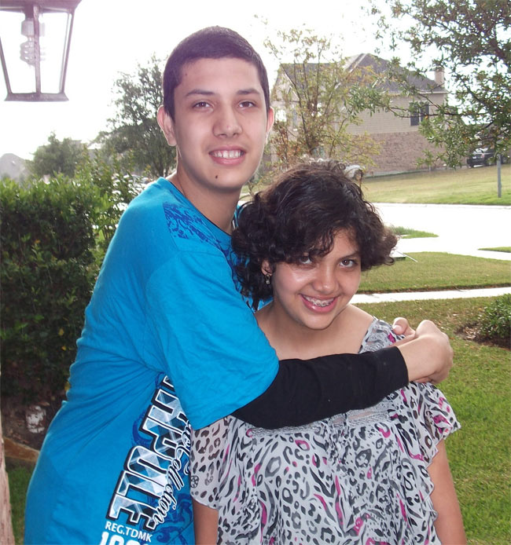
Jonathan and Vanessa
TARE ID #24286
Ages: 17 and 16
Region: 6
“We enjoy playing and watching television together. We have similar interests, but also have additional individual interests.”

Slide 24
Michelle
TARE ID #33187
Age: 16
Region: 3
“I love to watch cartoons!”
Her worker says, “Michelle is funny and has a very active imagination. She loves to play outside and explore things!”

Slide 25
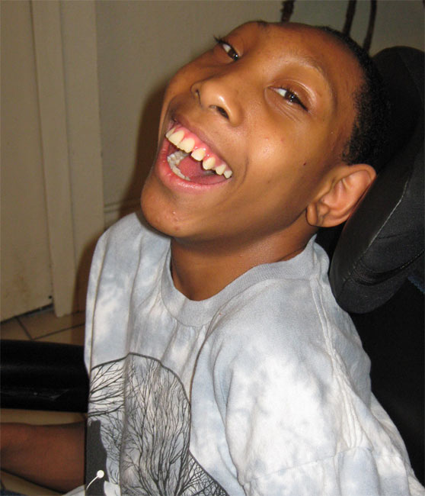
DeMichael
TARE ID #41090
Age: 16
Region: 3
“I am a happy boy with a sweet smile who enjoys laughing and interacting with people.”
His caseworker says, “DeMichael is such a sweetie. He requires total care and I hope to find a forever home for him.”

Slide 26
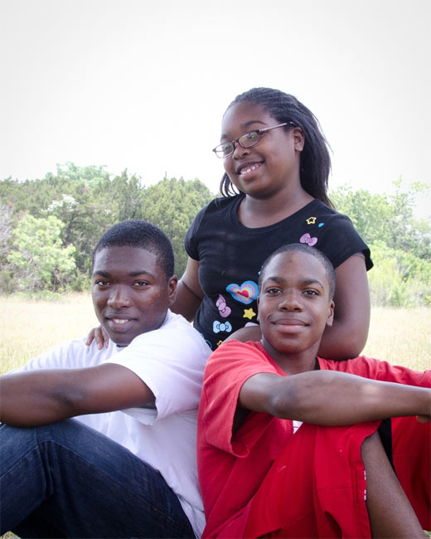
Jason, Ivory, and Harriniqa
TARE ID #25948
Ages: 17, 16, and 12
Region: 7
“We're engaging, outgoing, and waiting for a family who can raise us together.”
Their worker says, “This sibling group is outgoing and brave. They look out for each other and remain loyal to each other.”

Slide 27
Franklin
TARE ID #44795
Age: 11
Region: 1
“Must love horses!”
His worker says, “Franklin is active and enjoys the outdoors. He likes horses and would like to live out in the country like the cowboys."

Slide 28
Texas Faith Based Collaboration Model
CPS has conservatorship;
The church has stewardship;
and Communities have ownership.
~ Bishop Aaron Blake ~
Greater Faith Community Church
Brownwood, TX

Slide 29
The Faith Based Community Has Joined the Effort
Faith-based organizations help with prevention, foster care and adoption, and youth transitioning to independent living
Currently there have been 114 churches recruited to participate in the Faith Based Collaboration
107 churches attended informational meetings with the intent to develop and launch Faith Based Ministries in the future
16 churches have begun recruiting foster/adopt families
13 other Orphan Care Ministries have been launched

Slide 30
DFPS Child Data
7,159,172
Children Living in Texas for FY 2013
27,924
Children were in the state’s conservatorship
on August 31, 2013
229,138
Total CPS Initial Intakes of Abuse/Neglect
160,240
Abuse/Neglect Investigations Completed by CPS
16,676
Children were in paid foster care
10,059
Children were in Kinship Care
1,189
Children were in Other Settings
66,398
Confirmed Victims of Abuse/Neglect

Slide 31
Child Fatalities in the General Population

Slide 32
Child Safety Plan
DFPS developed a child safety action plan that includes implementation of the recommendations in an internal audit and changes proposed in response to specific child fatality cases, identified trends, or as a recommendation from a child safety forum with providers and stakeholders.
Areas addressed in the child safety plan include:
Child fatality review process
Kinship Care
Foster Care
DFPS training and casework practices
Regulation of contracted providers

Slide 33
A Happy Ending!
The Cavazos family after adoption proceedings.
Damien Cavazos, who turned 18 the very next day, put his arms around his new mom, Rebecca Cavazos, at far left of the photo.

